Slide 1
Wellcome Researchfish Submission & Annual Reporting 2020
13 January 2020

Slide 2
Presenters
Paul Mal
Grants Information Officer
Saba Shakib
Operations Manager – Insight & Analysis
Mike Niedzwiecki
Grants Information & Training Manager

Slide 3
Agenda
Researchfish
Who is submitting
Key dates for submitting
Grantholders that have left the university
How we use Researchfish data
2. Annual Reporting
Who is submitting
Key dates for submitting
Demo on finding the Annual Report
How we use Annual Report data
Questions: www.slido.com
Event code #7463

Slide 4
Researchfish
Some grants ending between 1 October 2019 – 30 September 2020.
Not all grants will be reporting through Researchfish.
A list of schemes can be found on the website:
https://wellcome.ac.uk/funding/guidance/end-grant-reporting
Or search ‘end of grant reporting’ on wellcome.ac.uk
Questions: www.slido.com
Event code #7463

Slide 5
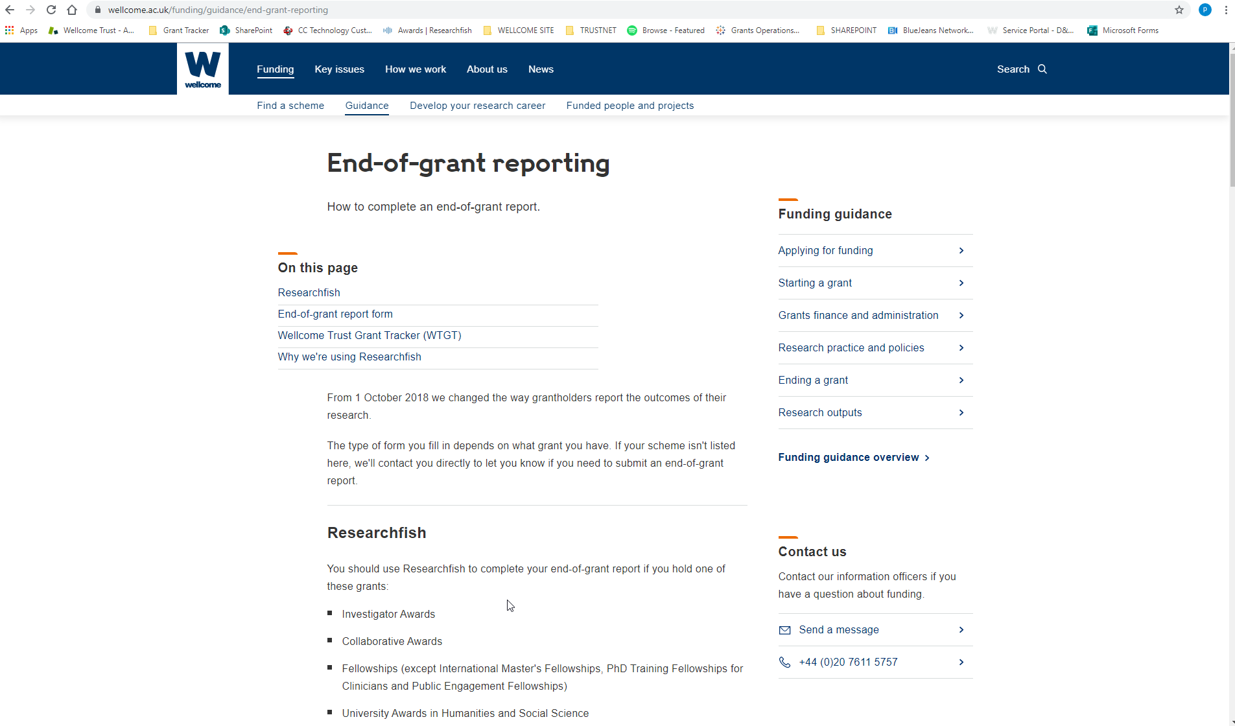
Researchfish

Slide 6
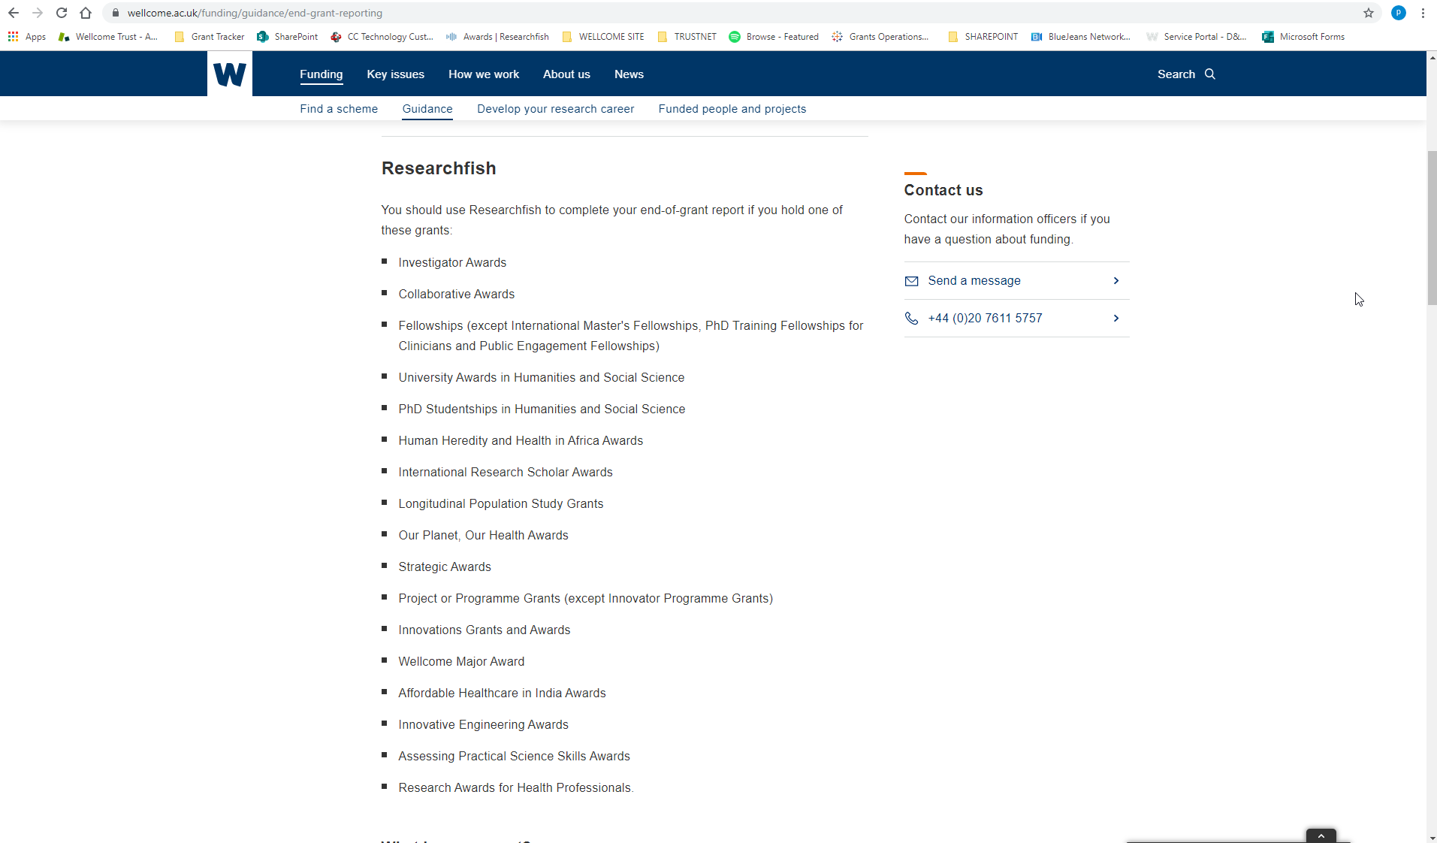

Slide 7
Researchfish
Unsure if the grant uses Researchfish?
grantenquires@wellcome.ac.uk
Wellcome uses Researchfish for end of grant reporting only.
Questions: www.slido.com
Event code #7463
Notes:
Unlike other funders we only use RF for EogR, and not ARs

Slide 8
Researchfish
Grant holders can enter outputs into Researchfish now.
Submission period is 3 February to 12 March 17:00 (GMT)
Questions: www.slido.com
Event code #7463

Slide 9
Researchfish
Grantholder has left the university?
grantenquires@wellcome.ac.uk
System issues – contact Researchfish:
support@researchfish.com
Questions: www.slido.com
Event code #7463

Slide 10
How we use Researchfish data
Not used for decisions about individual grants such as renewals, supplements or extensions
Instead, it improves our understanding at portfolio level in three main ways: for funding teams, understanding what grantees are doing; for the evaluation team, monitoring outputs and outcomes against our Success Framework; for our Grants team, monitoring open access and clinical trial policies
Self-reported data provided by our grant holders is never used in isolation but always as part of a broader mix of data to support strategic decision making – alongside data from public databases, data from staff and external peer review
Questions: www.slido.com
Event code #7463

Slide 11
Use case 1: improving our identification of academic research outputs such as papers, databases, books and monographs
Researcher submissions of research outputs through Researchfish help us improve our coverage of research outputs that acknowledge Wellcome.
We then use other databases to retrieve additional information on these outputs.
ResearchFish research outputs
Funder acknowledgement data
Indicators for:
research influence
open access compliance
+
Other sources (Dimensions)
Publication-related data
e.g. RCR and OA status
Questions: www.slido.com
Event code #7463

Slide 12
Use case 2: monitoring translational outputs and follow-on of grants
Researcher submissions of research outputs through Researchfish help us identify translational potential.
We use further data requests to get additional information on the status of outputs initially flagged through Researchfish.
ResearchFish translational outputs
IP licensing data
Indicators for:
translation engagement
health intervention development
health impact
+
TTO licensing and translational partnership reports
Follow up with awardees
reporting health interventions

Slide 13
Annual Report
Not all grant holders are required to submit an annual report.
Those required to submit were contacted in December 2019.
Submission period is 13 January to 13 February 2020.
Report will be submitted through the grantholder’s Grant Tracker account.
Questions: www.slido.com
Event code #7463

Slide 14
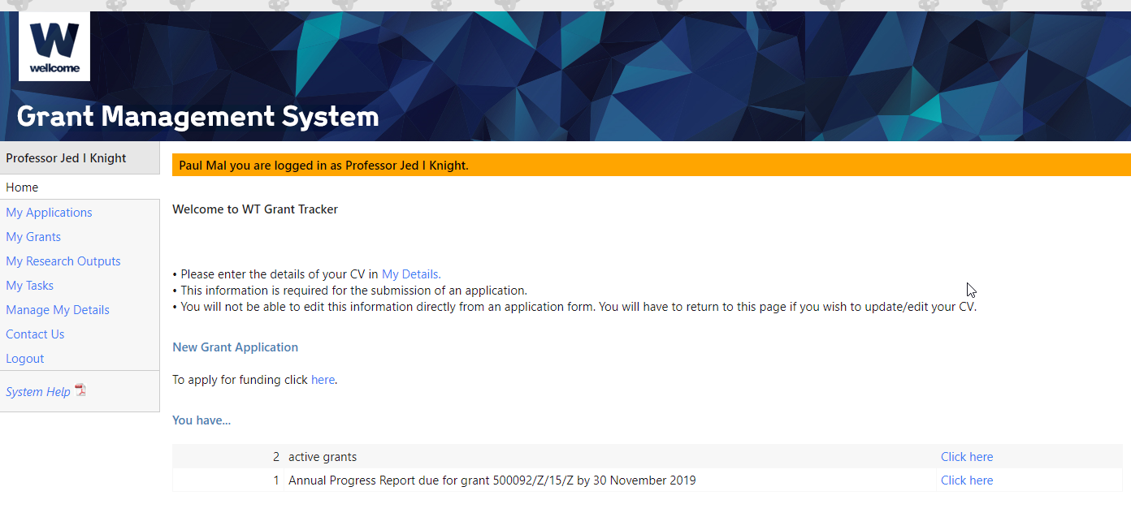

Slide 16
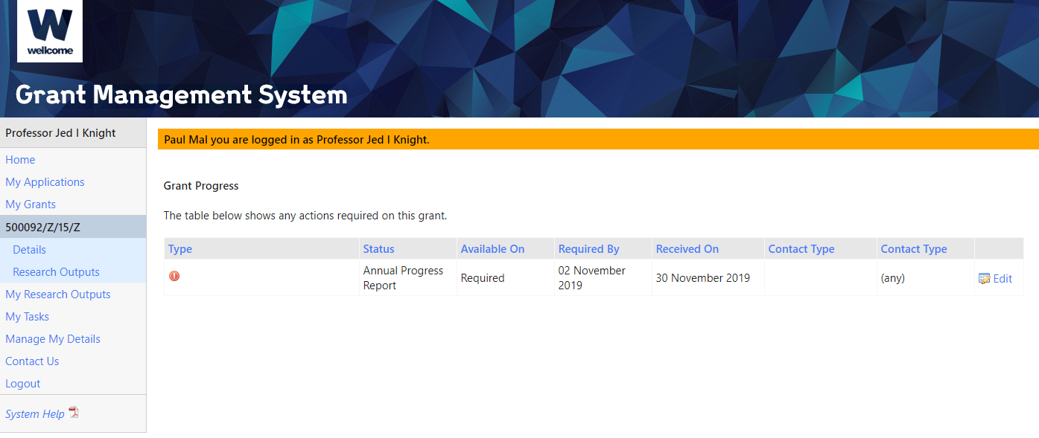

Slide 17
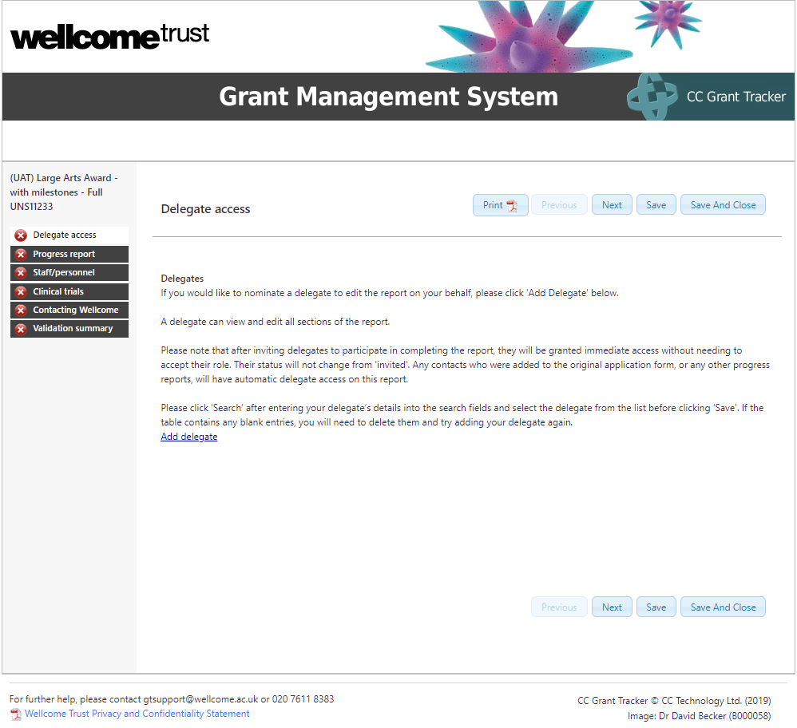

Slide 18
Annual report
Annual report templates are available all year round here:
https://wellcome.ac.uk/funding/guidance/how-report-grant-progress
Or search ‘grant reporting’ on wellcome.ac.uk
Questions: www.slido.com
Event code #7463

Slide 19
How we use Annual progress reporting data
Research progress update used by our Funding and Grants teams
Reports are not used for evaluating outputs or outcomes. They are used to monitor how our awards are progressing and gain insight into the work Wellcome supports
Used for portfolio management (direct engagement with grant holders which enables us to keep up to date on progress and allow issues to be flagged)
Provides a mechanism by which Wellcome can offer help and support to grant holders
Clinical trial compliance is also assessed through these reports
Questions: www.slido.com
Event code #7463

Slide 20
Thanks!
Contact
grantenquiries@wellcome.ac.uk

Slide 21
Questions
Can researchers submit their Annual Reports through Researchfish?
No. Annual Reports are currently only submitted through Wellcome Trust Grant Tracker
Questions: www.slido.com
Event code #7463

